Slide 1

A Comparative Analysis of Implementing a Deconvolution of a Diffused Image in real-time as a front-end for Calcium Imaging
University of North Dakota EE department
BME690, Ray Duran
5/8/22

Slide 2
Agenda
Motivation/Applications
Background
Calcium Imaging
Diffusers
GPU
CPU
FPGA
Methods
System Implementation
Results
Discussion/Conclusion

Slide 3
Motivation
Problem: In-vivo calcium imaging with a diffuser to improve FoV and resolution tradeoffs, but what architecture to use for reconstruction
Related work:
Research at UCLA from Jason Cong
Research at UC. Berkeley with Laura Waller
Investigate GPU,CPU and FPGA devices
Lay foundation for future work and algorithm

Slide 4
Applications
In Vivo microscopy and neurological imaging
The problem of scattering in biological tissue is a challenging open topic today in microscopy.
How to solve depth problem vs resolution in real time
As an example confocal( low depth and high resolution) vs MRI with high depth but low resolution.
Notes:
In vivo microscopy and the 4th BME seminar.

Slide 5
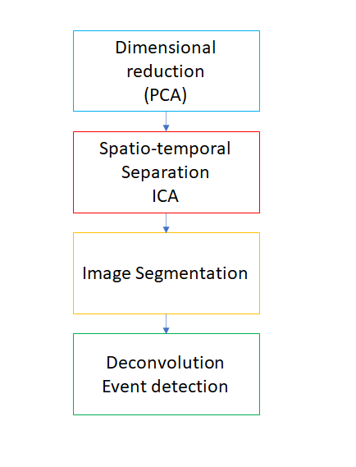
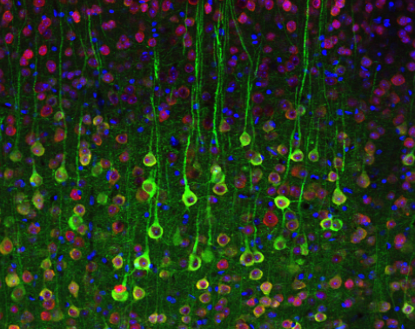
Calcium Imaging

Slide 6
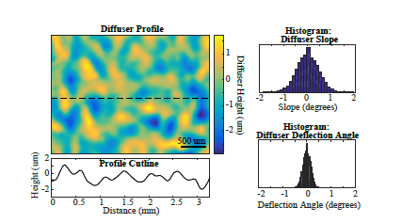
Diffusers
Can be thought of as random matrix
Notes:
Here is that medium.; A diffuser can be thought of as a kind of random matrix. So, all we would then need is for our voxels to be sparse in some domain. As we saw earlier in Professor Liang’s lecture on compressive imaging, we are saved as a random matrix multiplied by another matrix is still random. So, if we transpose our solution into a spare domain with some matrix we are still random.

Slide 7
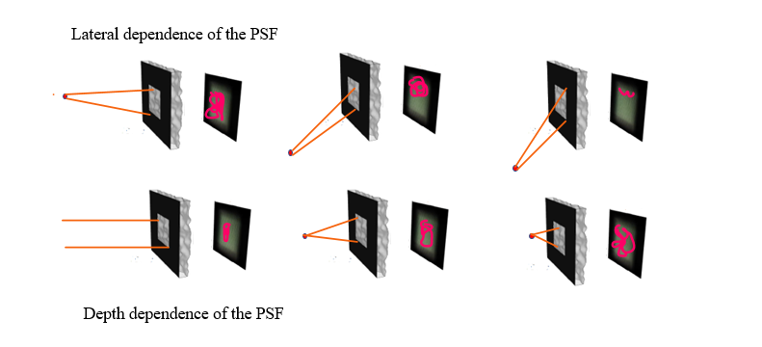
Diffusers
Uniqueness of Patterns
Randomness from diffuser
creates a type of spectral
signature from every point
source in our object
The depth acts as a scaling
function while the lateral is a shift
Notes:
And if you remember from linear systems, a shift is just a re-cyle of data in the convolution matrix;
Caustics from diffuser; High-frequency in all directions; Highly structured PSF for deconvolution

Slide 8
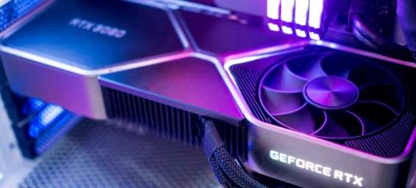
GPU
CUDA, Threading & synchronization

Slide 9
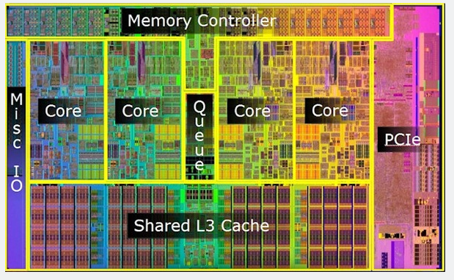
CPU
C++, Caching & Multicores

Slide 10
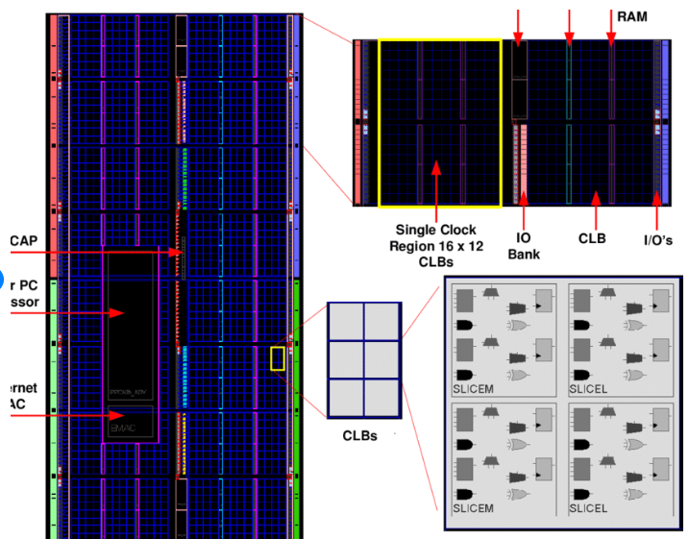
FPGA
HDL, Block Ram & concurrency

Slide 11
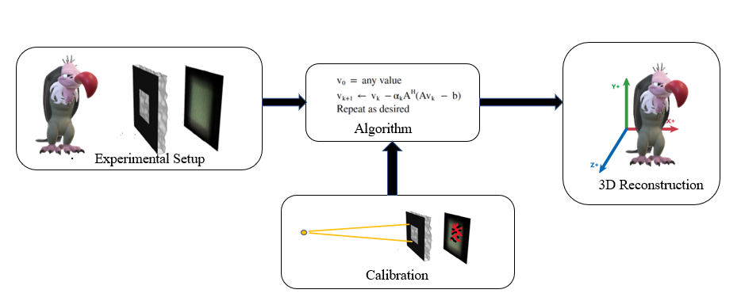
Methods
Overall System
Notes:
In the equation b = Hv; H is the forward model whose columns consist of the caustic patterns.
Here we would like to have something faster to compute for 3-D imaging. We use the FISTA in our experiments. The ADMM is a popular optimization these days. Basically, if you have a way of separating the problem into two convex functions, and you can then make your constraints linearly then there is a big speedup. This method is related to a penalty of Lagrangian methods. Antipa builds a forward convolutional model; Incorporates a cropped convolution;Trick of not using H directly;Confirms random matri and use of compressed sensing;In Theory allows a simple calibration

Slide 12
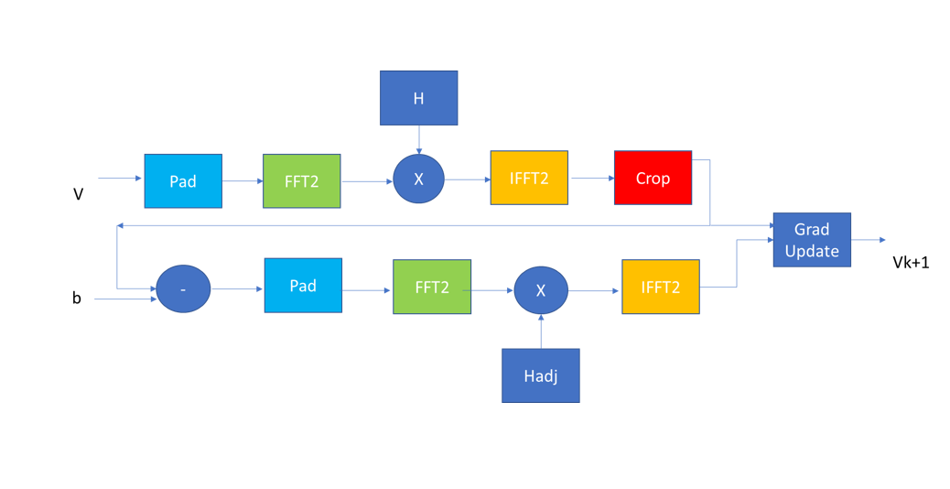
System Implementation

Slide 13
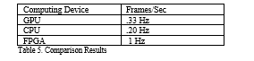
Results
Latency frame speed

Slide 14
Discussion/Conclusion
iterations
precision
Mix and Matching
Use of ADMM
Conclusion: FPGA has lowest latency among CPU and GPU

Slide 15
Partial References
N. Antipa et al., “DiffuserCam: lensless single-exposure 3D imaging single-shot,” Optica 5,1-9 (2018).
J. Adams, et al., “ Single-frame 3D fluorescence microscopy with ultraminiature lensless Flatscope,”Sci. Adv,3 (2017)
R. Lacouture, “ GPUBLQMR: GPU-Accelerated Sparse Block Quasi-Minimum Residual Linear Solver,” Master Thesis, Northeastern University, (2021)
Y. Ogata, et al., “An Efficient, Model-Based CPU-GPU Heterogeneous FFT Library,” IEEE Explore, (2008)
S. Markidis, S. Chien,E. Laure, “ NVIDIA Tensor Core Programmability & Precision,”European Commision
K. Nguyen, J. Zheng, Y. He, and B. Shah, “ A High-Throughput , Adaptive FFT Architecture for FPGA-Based Space-Borne Data Processors, “ NASA Contract

